Slide 1
Energy Balance

Slide 2
Graded Quiz Question #1
Which food has the most Calories per gram (grams of Carb/Protein/Fat in parentheses)?
Maple Syrup (67/0/0)
Atlantic Cod (0/62/3)
Hazelnuts (17/15/60)
They are all the same Calories/g
Notes:
C

Slide 3
Graded Quiz Question #2
According to the paper on liking and wanting food, how do the authors propose that palatability interacts with physiological signals of fullness
Liking food is always dependent on wanting food
Engagement of reward circuits blunts signaling of satiety peptides
In a study on Pima Indians, a heightened taste response to sweet and creamy solutions was associated with less weight gain.
Accurate reconstruction of emotional responses to food is not vulnerable to excessive cognitive processing
Notes:
B

Slide 4
Graded Quiz Question #3
Which hormone is secreted from your gut when it is not full
Gastrin
CCK
Ghrelin
GLP1
Notes:
A

Slide 5
Essentiality, Energy and Efficiency
Essentiality
What can we make? what must we ingest?
Energy from macronutrients
Efficiency of digestion and metabolism

Slide 6
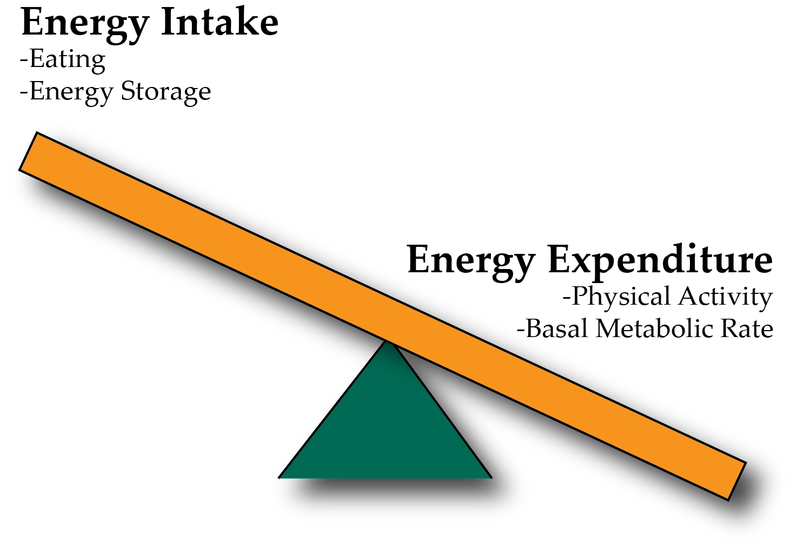
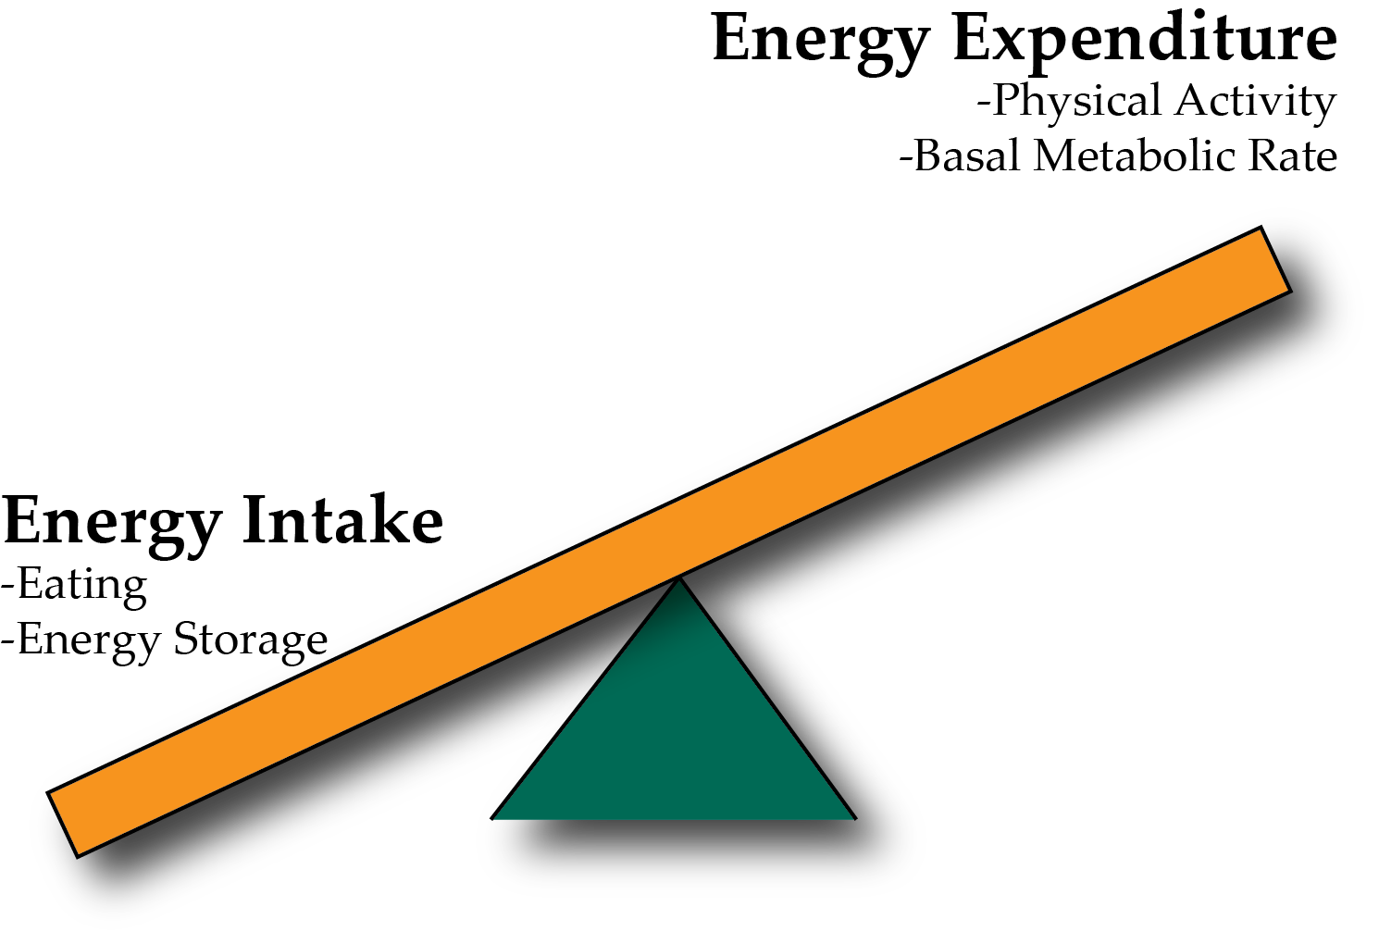
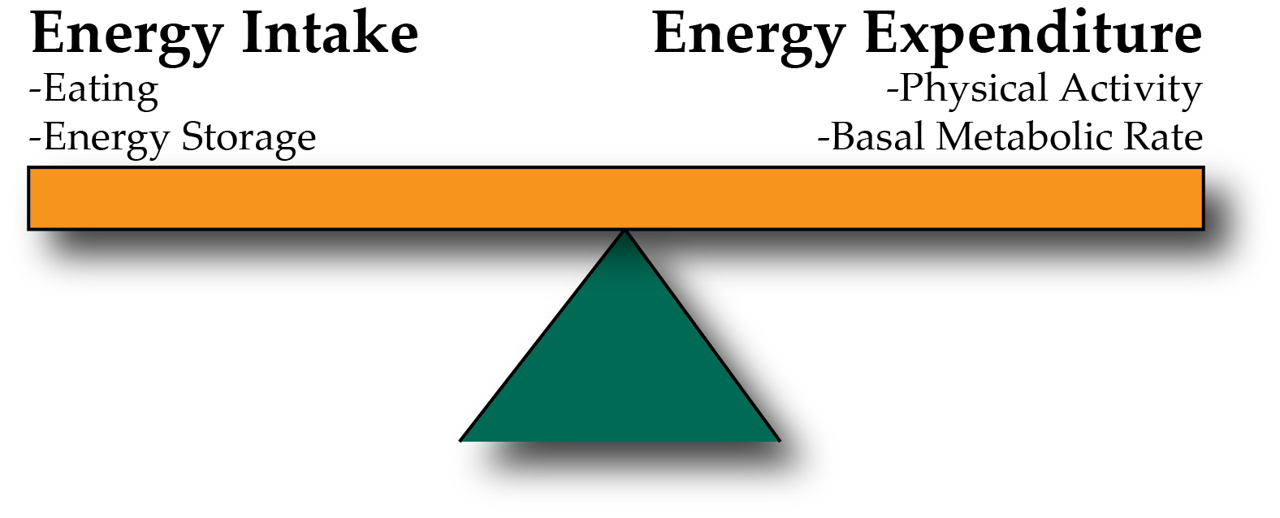
Energy Balance and Obesity
Positive Energy Balance – Weight Gain
Negative Energy Balance – Weight Loss
Notes:
Be here at 9:20

Slide 7
Concept Map

Slide 8
Terms for your concept map
Energy Intake
Energy Expenditure
Sensing Fullness
Appetite
Energy Excretion
Atwater Factor
Basal Metabolic Rate
Thermic Effect of Food
Exercise Activity Thermogenesis
Ghrelin
Digestive Efficiency
Energy Balance
Weight Gain
Weight Loss
FFQ
24h Diet Recall
Fecal Energy Content
Gut Nutrient Sensing
Calories in Food
Energy Ingested
Palatability
Desire to eat

Slide 9
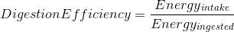
Assessing Energy Intake
Several methods of assessing energy intake
Observational
Diet Recall Surveys
Food Frequency Questionnaires
More about diet recalls in an optional assignment
Notes:
Start at 1:15

Slide 10
Why do we start and stop eating?
Why do we eat
Why do we stop eating
Drive for food
Low blood glucose
Stress
Stomach is full and full of nutrients
Changes in gut-derived hormones
Vagal signaling
Rise in insulin and glucose
~20 minute lag between eating and feeling full
Notes:
Liking -> rewards associated with food, like taste
Wanting -> desire for food

Slide 11
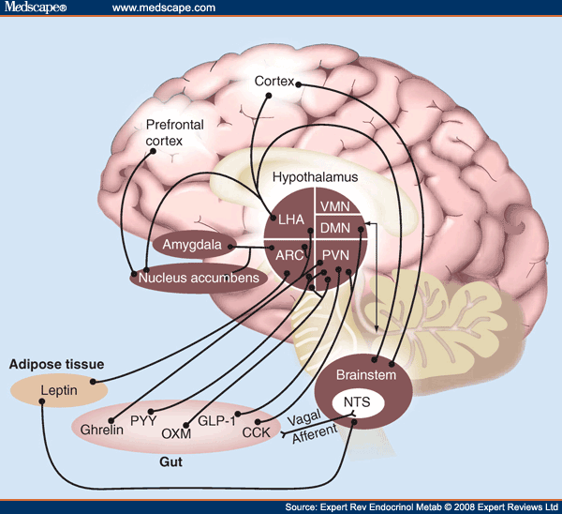
The Central Role of The Hypothalamus

Slide 12
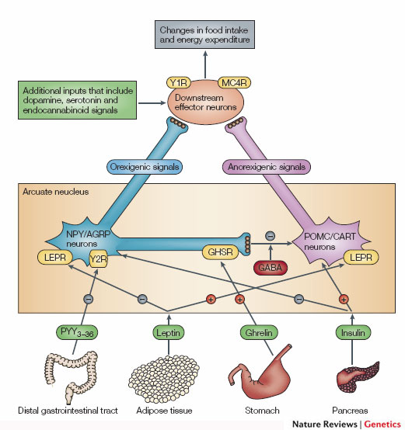
The Central Controller of Appetit is a Circuit in the Hypothalamus (NPY/POMC neurons)
Promotes
Eating
Suppresses
Appetite
Notes:
Two populations of neurons in the arcuate nucleus.

Slide 13
Stress
Cortisol activates hypothalamic AgRP/NPY neurons
These neurons promote feeding
Activation drives feeding behavior
Notes:
mistake on this slide

Slide 14
Timed feeding cues
Cortisol awakening response
Sharp rise in cortisol shortly before waking up
May differ between chronotypes
How do you think this would affect feeding behaviors?
Kudielka BM, Federenko IS, Hellhammer DH, Wüst S. Morningness and eveningness: The free cortisol rise after awakening in “early birds” and “night owls.” Biol Psychol. 2006; 72: 141–6. doi: 10.1016/j.biopsycho.2005.08.003.

Slide 15
Why do we stop eating?
The role of our gastrointestinal system
Notes:
~20 minute lag between eating and feeling full

Slide 16
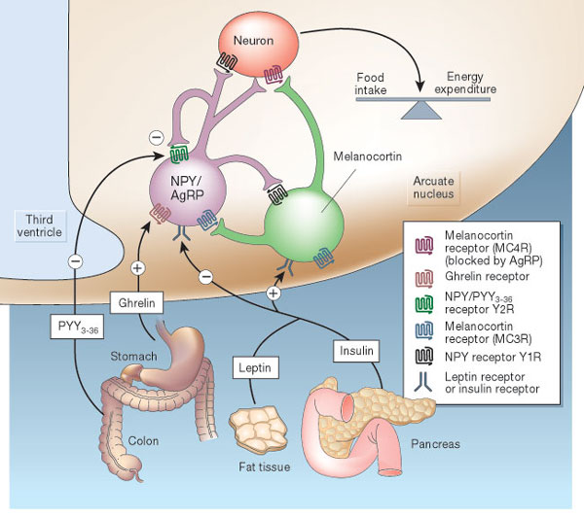
Hormonal Control of Appetite
-
GLP1
Notes:
Think about it this way… AgRP neurons like to be on, and when they are on they increase appetite.

Slide 17
Vagal Nerve Signaling
Notes:
Enteric nervous system
Second brain
500 million neurons

Slide 18
Metabolic Signals
Glucose
GLP1 in the small intestine
Sensed directly by hindbrain and hypothalamus
Insulin
Sensed at hypothalamus
Proteins and Lipids
In the gut (CCK)
In the liver (FGF21)
May be direct sensing at hypothalamus
Leptin
Related to adipose tissue size

Slide 19
Summary of gut signals
Signal | Effect of food | Effect
Vagal stimulation | Stimulation | Inhibitory
GLP-1 | Secreted by small intestine | Inhibitory
PYY (Peptide YY) | Secreted by small intestine | Inhibitory
CCK | Secreted by small intestine | Inhibitory
Ghrelin | Stomach secretion stops with food | Activating

Slide 20
Mindful Eating Thought Experiment
Normal signals regulate drive to eat, and feelings of fullness
Dieting may change our normal responses
Mindful eating is proposed to restore normal sensing
Pretend you have an study of people who are or are not trained in mindful eating.
At your table, pick a physiological factor that you hypothesize would be different between these groups. How would it be different? How do you think intuitive eating might cause these effects?
Notes:
Be here at 1:45-1:55
One paper showed that higher resting vagal activity was associated with a lower willingness to eat desired foods (which would be associated with more diet restriction)

Slide 21
Other functions of GI hormones

Slide 22
Endocrine Regulation of GI Function
Notes:
Why may bicarbonate secretion be important?

Slide 23
Summary of Enteroendocrine Hormones
Hormone | Released from | Roles
Gastrin | Stomach (amino acids, stomach stretch, PNS) | Release acid into stomach, increase motility
Secretin | Small Intestine (acid) | Release bicarbonate into small intestine
CCK (Cholecystokinin) | Small Intestine (fatty acids and amino acids, PNS) | Bile Secretion, Pancreatic Enzyme Secretion, reduces motility
Motilin | Small Intestine | Increased motility
Parasympathetic Nervous System | Brain | Rest and digest, release of CCK, Gastrin
Sympathetic Nervous System | Brain | Fight or flight, pyloric sphincter

Slide 24
Interested in, or need a refresher in anatomy?

Slide 25
Energy Expenditure

Slide 26
Parts of the Metabolic Rate
Energy Expenditure Component | Increased by
Exercise Activity Thermogenesis (NEAT/EAT) | Exercise and movement
Thermic Effect of Food (TEF) | Protein in Meal, Insulin Sensitivity, Meal Size
Basal Metabolic Rate | Young Age, Sex (M), Lean Mass, Set Point
Maclean PS, Bergouignan A, Cornier M-A, Jackman MR. Biology’s response to dieting: the impetus for weight regain. Am. J. Physiol. Regul. Integr. Comp. Physiol. 2011;301(3):R581–R600. http://dx.doi.org/10.1152/ajpregu.00755.2010
Notes:
Impact of weight loss on the components of total energy expenditure (TEE). Energy-restricted weight loss impacts every component of energy expenditure. The absolute levels of resting energy expenditure (REE) decline from a loss of metabolic mass and enhanced metabolic efficiency. Nonresting energy expenditure (NREE) declines, unless the level of physical activity and its associated exercise activity thermogenesis (EAT) are substantially increased. This increase must overcome the decline in the TEF that results from lower energy consumption and a decline in nonexercise activity thermogenesis (NEAT) related to loss in overall mass. Increased energetic efficiency of EAT, NEAT, and potentially TEF contribute to the overall decline in NREE.

Slide 27
Energy Expenditure and Metabolism
Notes:
Collectively the non-fat proportion is called fat free mass or lean mass

Slide 28
Major Determinants of Resting Energy Expenditure
Amount of metabolically active tissue (fat-free mass)
Strong relationship between REE and Fat-Free Mass
Modified by
Age (declines with age)
Sex (~11% higher in males)
Genetics (V_{g} ~ 11%)
Illner K, Brinkmann G, Heller M, Bosy-Westphal A, Muller MJ. Metabolically active components of fat free mass and resting energy expenditure in nonobese adults. Am J Physiol Endocrinol Metab. 2000; 278: E308-15.
Notes:
The major factors that contribute to the BMR are age (declines with age), sex (approximately 11 % higher in males) and body mass, particularly fat-free (or lean) mass. Up to 85 % of the variance in BMR can be explained by these factors,

Slide 29
Using Energy Balance Concepts
If one knows the energy intake, and the energy expenditure you can calculate energy surplus (or deficit)
This surplus (or deficit) changes the energy stored in our body (primarily in our fat depots)

Slide 30
Deriving 500 Calorie “Rule”
Calculate the number of calories stored in one pound (454g) of fat tissue based on its Atwater factor and the percent of lipid in fat (87% lipid).
What daily caloric deficit would be needed, presuming Energy Expenditure is constant. Calculate this for a timeframe of:
One week
One month
One day
Notes:
1 -> 454 g x 0.87 x 9 kca/g = 3500 calories
2 -> 500 cal/day (week), 118cal/day (month) or 3500 cal/day (day)

Slide 31
This does not work, why?

Slide 32
Over/underfeeding and metabolic rates
Leibel R, Osenbaum MIR, Leibel RL, Rosenbaum M, Hirsch J. Changes in energy expenditure resulting from altered body weight. N. Engl. J. Med. 1995;332(10):621–8. http://dx.doi.org/10.1056/NEJM199503093321001

Slide 33
The Biggest Loser Follow-Up Study
Notes:
Those with sustained weight loss, did so even in spite of a more pronounced reduction in RMR after 6 years
The only time this adaptation went away was for those who regained that weight

Slide 34
A dynamic model of weight loss
Negative energy balance
Loss of mass
Reduction in energy expenditure
Less negative energy balance
Reduced weight loss
Dynamic modelling can be done using the NIH Body Weight Planner
https://www.niddk.nih.gov/bwp

Slide 35
Public Policy and Caloric Elasticity
USDA Report on a Soda Tax
Taxing Sodas at 20%
Estimated to reduce calories by 40 Cal/day
Projected 10% weight loss over 5 years
Non-adapted model
Adaptive model
Hall, K. D. et al. Quantification of the effect of energy imbalance on bodyweight. Lancet 378, 826–837 (2011).

Slide 36
How is appetite modified by weight loss?

Slide 37
How does weight loss affect appetite hormones
Why does ghrelin go down, but PYY go up with a meal?
Sumithran P, Prendergast LA, Delbridge E, Purcell K, Shulkes A, Kriketos A, Proietto J. Long-Term Persistence of Hormonal Adaptations to Weight Loss. N Engl J Med. 2011; 365: 1597–604. doi: 10.1056/NEJMoa1105816.
Notes:
Why would ghrelin go down, and why would PYY go up after a meal

Slide 38
What would this do to hunger
Less PYY
More Ghrelin
Hungrier
Less Hungry
Would be Balanced

Slide 39
How does weight loss affect hunger?

Slide 40
Think-Pair-Share: Implications for Treatment
Imagine you are working in a weight management clinic.
A patient has lost weight, but reports feeling hungry. What advice could you give?
What are some potential consequences of disregarding their report of elevated hunger?
Notes:
Stereotyping– make attributions of lazy, undisciplined
Results - less utilization of care, emotional eating, elevated ambulatory blood pressure, lower physical activity, depression
Encouragement to try “harder”/again leading to chronic dieting and weight cycling--associated with much worse health: all-cause mortality, physiological/metabolic outcomes

Slide 41
What is the relationship between intake and expenditure?

Slide 42
Relationship between activity and intake
Over a Day
Over the Week
Edholm OG. Energy balance in man studies carried out by the Division of Human Physiology, National Institute for Medical Research. J Hum Nutr. 1977; 31: 413–31.

Slide 43
Back to the Biggest Loser Cohort
Kerns, J. C. et al. Increased Physical Activity Associated with Less Weight Regain Six Years After “The Biggest Loser” Competition. Obesity 25, 1838–1843 (2017).

Slide 44
Why are activity levels the most predictive of sustained weight loss post diet?

Slide 45
Learning Objectives
Understand what a rate limiting enzyme is, what a committed enzyme step is and what a reversible reaction is.
Explain the differences in speed and persistence of allosteric, post-translational and transcriptional regulation of metabolism.
Describe the role of cellular transport in macromolecular regulation. Understand the differences between active and passive transport.
Describe how hormones alter macronutrient metabolism after a meal.
Explain the roles of hormones that maintain glucose levels in the fasting state.
Understand how metabolic rates are changed in response to diets and overfeeding.

